Slide 1



Career Counselling Chatbot
AI-powered solution for personalized career guidance
By Harshit Dabas(11022210070), Saksham Bhardwaj(11022210077)
SRM University, Delhi-NCR
Notes:
1

Slide 2

Abstract
Problem
Limited access to personalized career guidance
Solution
AI chatbot for natural language career advice
Technology
Python, Gradio, LLaMA 3 via Groq API
Impact
Democratizing access to expert guidance
Notes:
2

Slide 3
Introduction to Career Counselling
Traditional Model
Modern Challenge
AI Solution
Human counsellors with limited reach
Complex career landscape post-COVID
24/7 guidance at low cost
Notes:
3

Slide 4




Problem Statement
Cost Barrier
Fragmented Resources
Changing Landscape
Human counsellors
are expensive, limited availability
Online information
is confusing & overwhelming
Remote work, gig economy require new insights
Notes:
4

Slide 5






Project Objectives
Human-like AI Chatbot
Natural career conversations
Self-Assessment Tools
Personalized guidance
Accessible Interface
Any device, no technical expertise
Notes:
5

Slide 6



Project Scope
Browser-based Application
Gradio tabbed interface
LLaMA 3 Integration
Via Groq API
Core Functionality
Conversations, assessments, resources
Notes:
6

Slide 7








Significance & Impact
24/7 Access
Remote Areas
Always available guidance
Serving under-resourced regions
Human Development
Educational Support
AI serving real needs
Enhancing institutional resources
Notes:
7

Slide 8

Tools & Technologies
Python
Backend logic, API integration
Gradio
UI components, web deployment
Groq API
Access to LLaMA 3 models
GitHub
Version control, deployment
Notes:
9

Slide 9
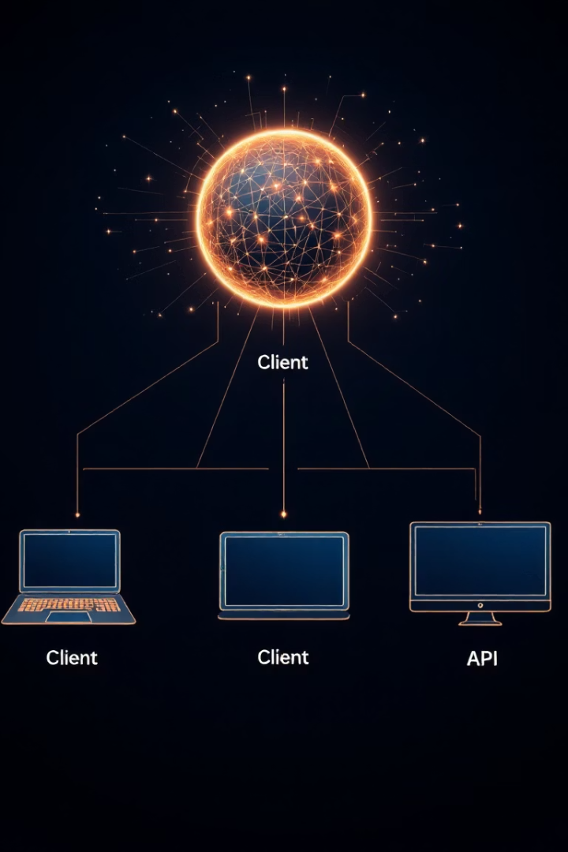



System Architecture
Frontend
Gradio interface, user interaction
Backend
Python, session management
External API
Groq for model inference
Notes:
10

Slide 10
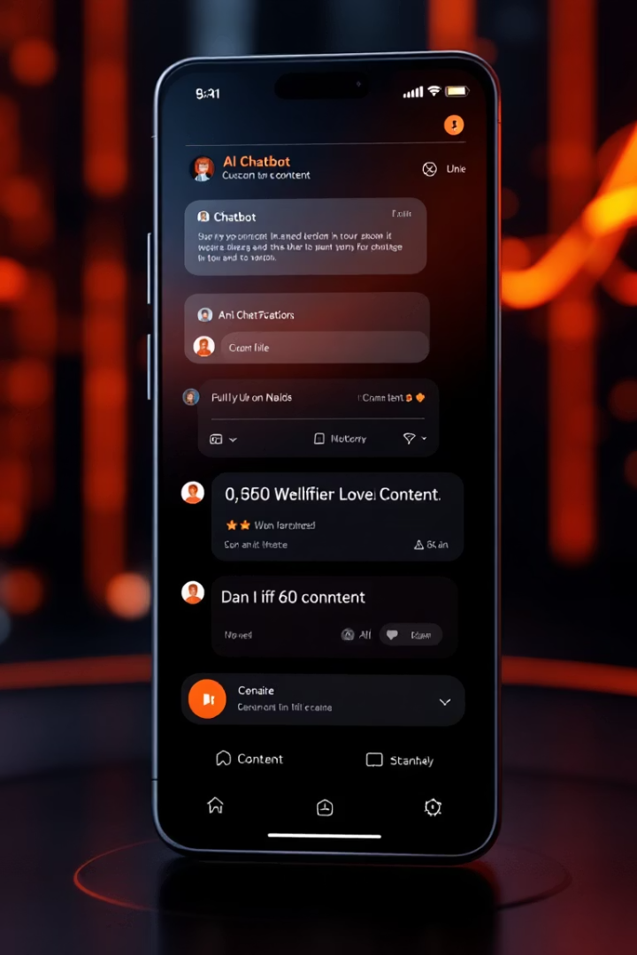
Core Functional Modules Overview
Exploring the main modules powering the AI career counselling chatbot platform.
Notes:
1

Slide 11

Core Functional Modules
Chat Engine
Manages dialogue and keeps session context active
Self-Assessment Generator
Prompts introspective questions on values and goals
Resource Tool
Suggests job platforms, internships, resume building, courses
Trends Tool
Returns up-to-date job market insights and emerging roles
Notes:
2

Slide 12

AI Implementation Strategy
Prompt Engineering
Fine-tunes chatbot as career counselor
Session Context
Stores conversation state in Gradio
Token Optimization
Limits verbosity while retaining clarity
Temperature Control
Balances creativity and factuality at ~0.7
Notes:
3

Slide 13
User Experience Design
Navigation
Conversational UI
Responsive Design
Human-like dialogue for trust and engagement
Optimized for phones, tablets, desktops
Three tabs: Chat, Tools, Trends
Notes:
4

Slide 14

Results & Feedback
7
Avg Session Time
Minutes per session
3.0
Guidance Accuracy
Rated out of 5
65%
Chat Usage
Most recommended tool
20%
Self-Assessment Usage
Second most used
Notes:
7

Slide 15
Ethical Considerations
Privacy
Transparency
No data storage, session cleared
AI identity clearly disclosed
Safety
Bias Mitigation
No sensitive mental health or legal advice
Balanced prompts avoid bias
Notes:
8

Slide 16
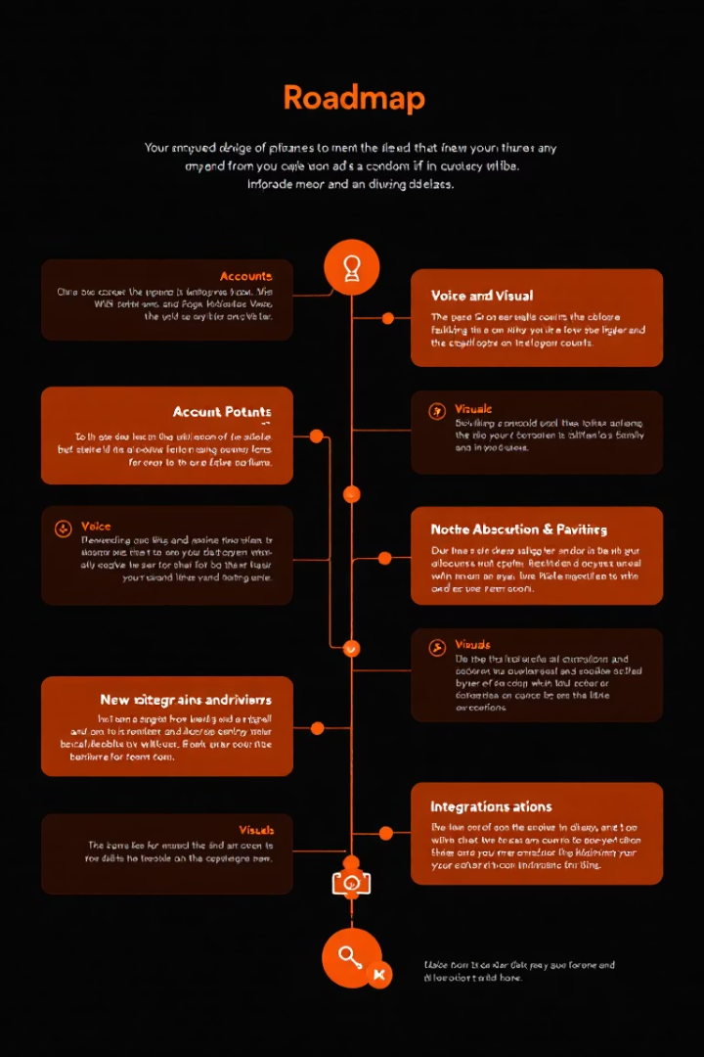
Limitations & Future Enhancements
Limitations
No persistent memory, no login
Text-only interface, no visuals
Depends on internet and APIs
Not suited for niche fields
Future Enhancements
User accounts and conversation history
Voice input and speech output
Visual dashboards and maps
Regionalized advice and platform integration
Notes:
9

Slide 17
Conclusion & Acknowledgments
The AI Career Counselling Chatbot empowers learners with accessible, smart guidance.
Combines AI intelligence with educational needs worldwide.
Acknowledgments
Mr. Shokendra Dev Verma, Supervisor
SRM CSE Department, Faculty
Notes:
10

Slide 18

Thank You
We appreciate your time and interest in our AI Career Counselling Chatbot project.
We look forward to advancing career guidance accessibility together.

